Slide 1
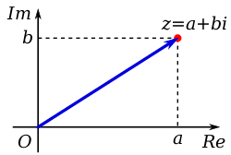
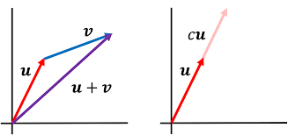
QM Foundations Quantum Computing
Aviral Shrivastava
Complex Numbers
Vector Spaces
Inner product spaces
Hilbert Space

Slide 2
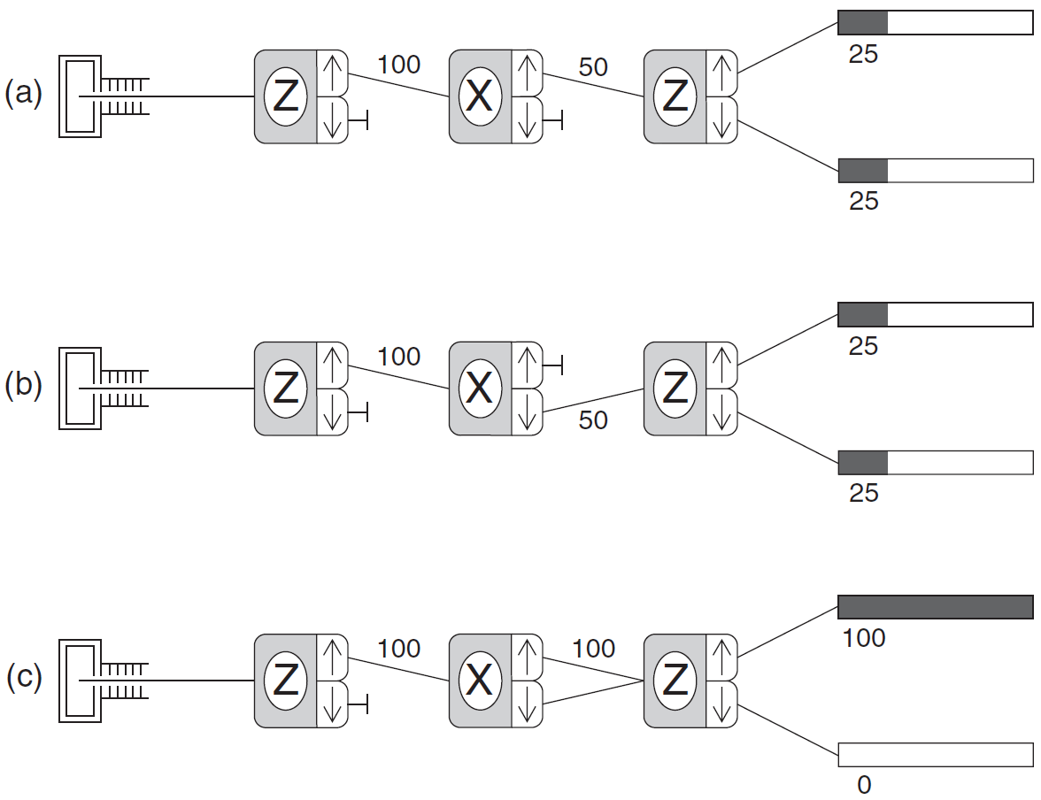
SG Experiment 4
Experiment 4a – Same as Experiment 3
Experiment 4a – Almost Same as Experiment 3
Experiment 4c
Classically, we would expect equal probabilities of particles exiting both the ports of the last SGA
Analyze the lower port. In Experiments 4a and 4b, half the atoms exit the lower port of the third analyzer. In Experiment 4c, no atoms make it through the lower port!
It is as if you opened a second window in a room to get more sunlight and the room went dark!
Interference

Slide 3
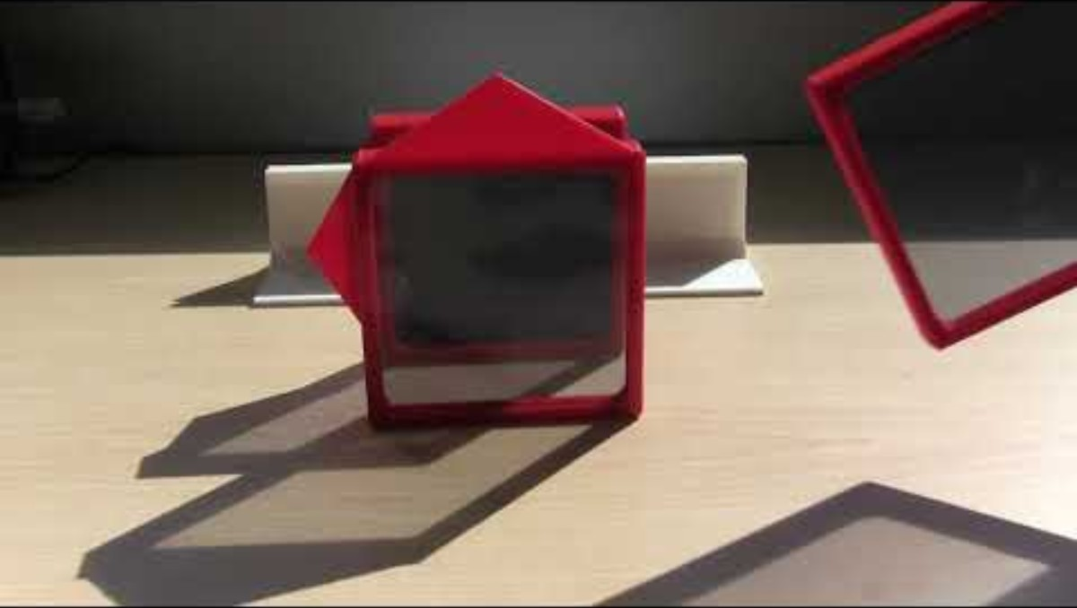

Same Effect with Polarizing filters
What do polarizers do?
Adding a ${45}^{0}$ polarizer between a vertical and horizontal polarizer enables the light to pass!!

Slide 4

Quantum State Vectors $|ψ⟩$
The state of a quantum mechanical system, including all the information you can know about it, is represented by a normalized ket, $|ψ⟩$.
These state vectors must employ complex numbers to properly describe quantum mechanical systems.
Quantum state vectors are part of a vector space that we call a Hilbert space.

Slide 5
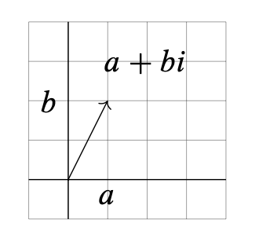
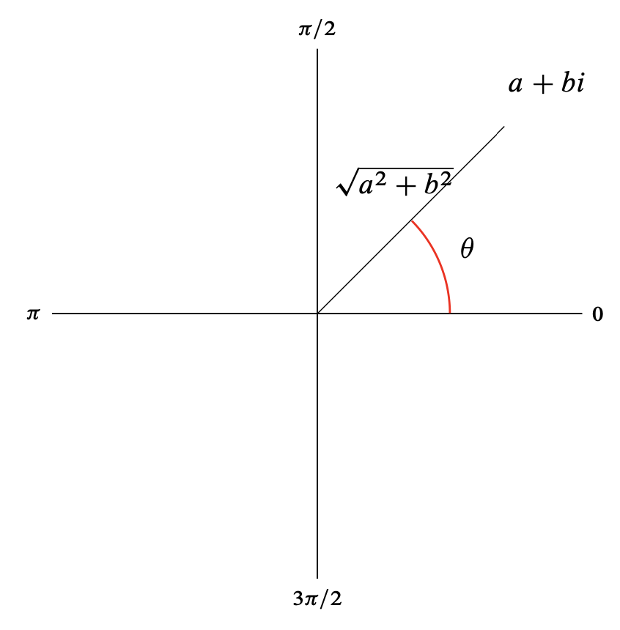
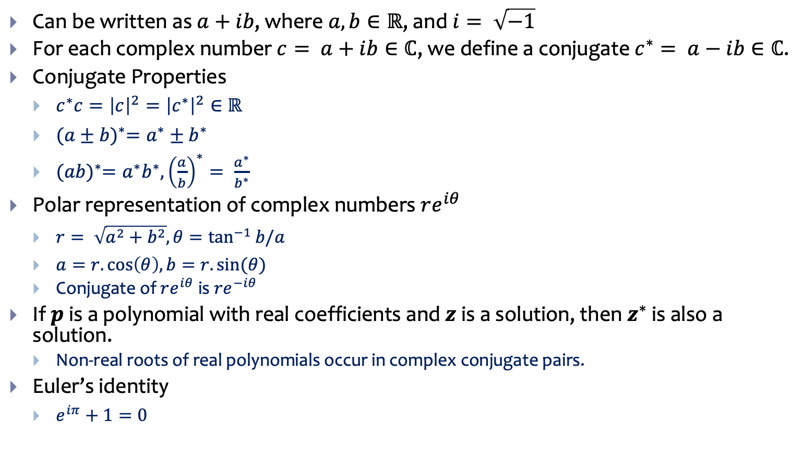
Complex Number Properties
Can be written as $a+ib$, where $a, b∈ℝ$, and $i= \sqrt{−1}$
For each complex number $c= a+ib∈ℂ$, we define a conjugate $c^{∗}= a−ib∈ℂ$.
Conjugate Properties
$c^{∗}c={\left|c\right|}^{2}={\left|c^{∗}\right|}^{2}∈ℝ$
${(a±b)}^{∗}=a^{∗}±b^{∗}$
${(ab)}^{∗}=a^{∗}b^{∗}, {\left(\frac{a}{b}\right)}^{∗}= \frac{a^{∗}}{b^{∗}}$
Polar representation of complex numbers $re^{iθ}$
$r= \sqrt{a^{2}+b^{2}}, θ=\tan^{−1}{b/a}$
$a=r.\cos\left(θ\right), b=r.sin⁡(θ)$
Conjugate of $re^{iθ}$ is $re^{−iθ}$
If $p$ is a polynomial with real coefficients and $z$ is a solution, then $z^{∗}$ is also a solution.
Non-real roots of real polynomials occur in complex conjugate pairs.
Euler’s identity
$e^{iπ}+1=0$
Complex numbers can be visualized in a 2D plane.

Slide 6
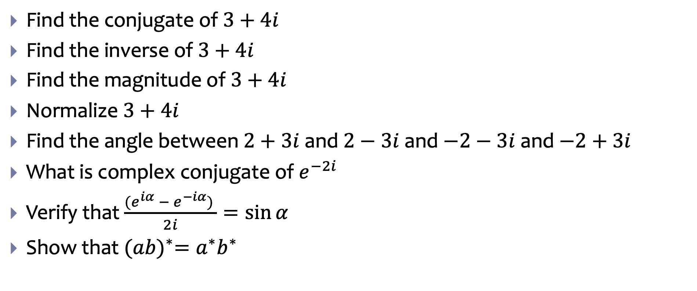
Some Complex Number problems
Find the conjugate of $3+4i$
Find the inverse of $3+4i$
Find the magnitude of $3+4i$
Normalize $3+4i$
Find the angle between $2+3i$ and $2−3i$ and $−2−3i$ and $−2+3i$
What is complex conjugate of $e^{−2i}$
Verify that $\frac{{(e}^{iα} −{ e}^{−iα}) }{2i}=\sin{α}$
Show that ${(ab)}^{∗}=a^{∗}b^{∗}$

Slide 7
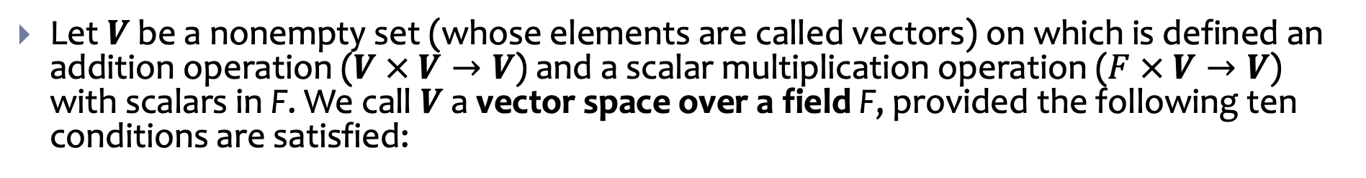
Vector Space
Let $V$ be a nonempty set (whose elements are called vectors) on which is defined an addition operation ($V × V→V$) and a scalar multiplication operation ($F × V→V$) with scalars in F. We call $V$ a vector space over a field F, provided the following ten conditions are satisfied:
A1. Closure under addition: For each pair of vectors u and v in V , the sum u + v is also in V . We say that V is closed under addition.
A2. Closure under scalar multiplication: For each vector v in V and each scalar k in F , the scalar multiple k v is also in V . We say that V is closed under scalar multiplication.
A3. Commutativity of addition: For all u, v ∈ V , we have u + v = v + u.
A4. Associativity of addition: For all u, v, w ∈ V , we have (u + v) + w = u + (v + w).
A5. Existence of a zero vector in V : In V there is a vector, denoted 0, satisfying v + 0 = v, for all v ∈ V.
A6. Existence of additive inverses in V : For each vector v ∈ V, there is a vector, denoted −v, in V such that v + (−v) = 0.
A7. Unit property: For all v ∈ V, 1v = v.
A8. Associativity of scalar multiplication: For all v ∈ V and all scalars r, s ∈ F , (rs)v = r(sv).
A9. Distributive property of scalar multiplication over vector addition: For all u, v ∈ V and all scalars r ∈ F , r(u + v) = ru + rv.
A10. Distributive property of scalar multiplication over scalar addition: For all v∈V and all scalars r,s ∈ F, (r + s)v = rv + sv.

Slide 8
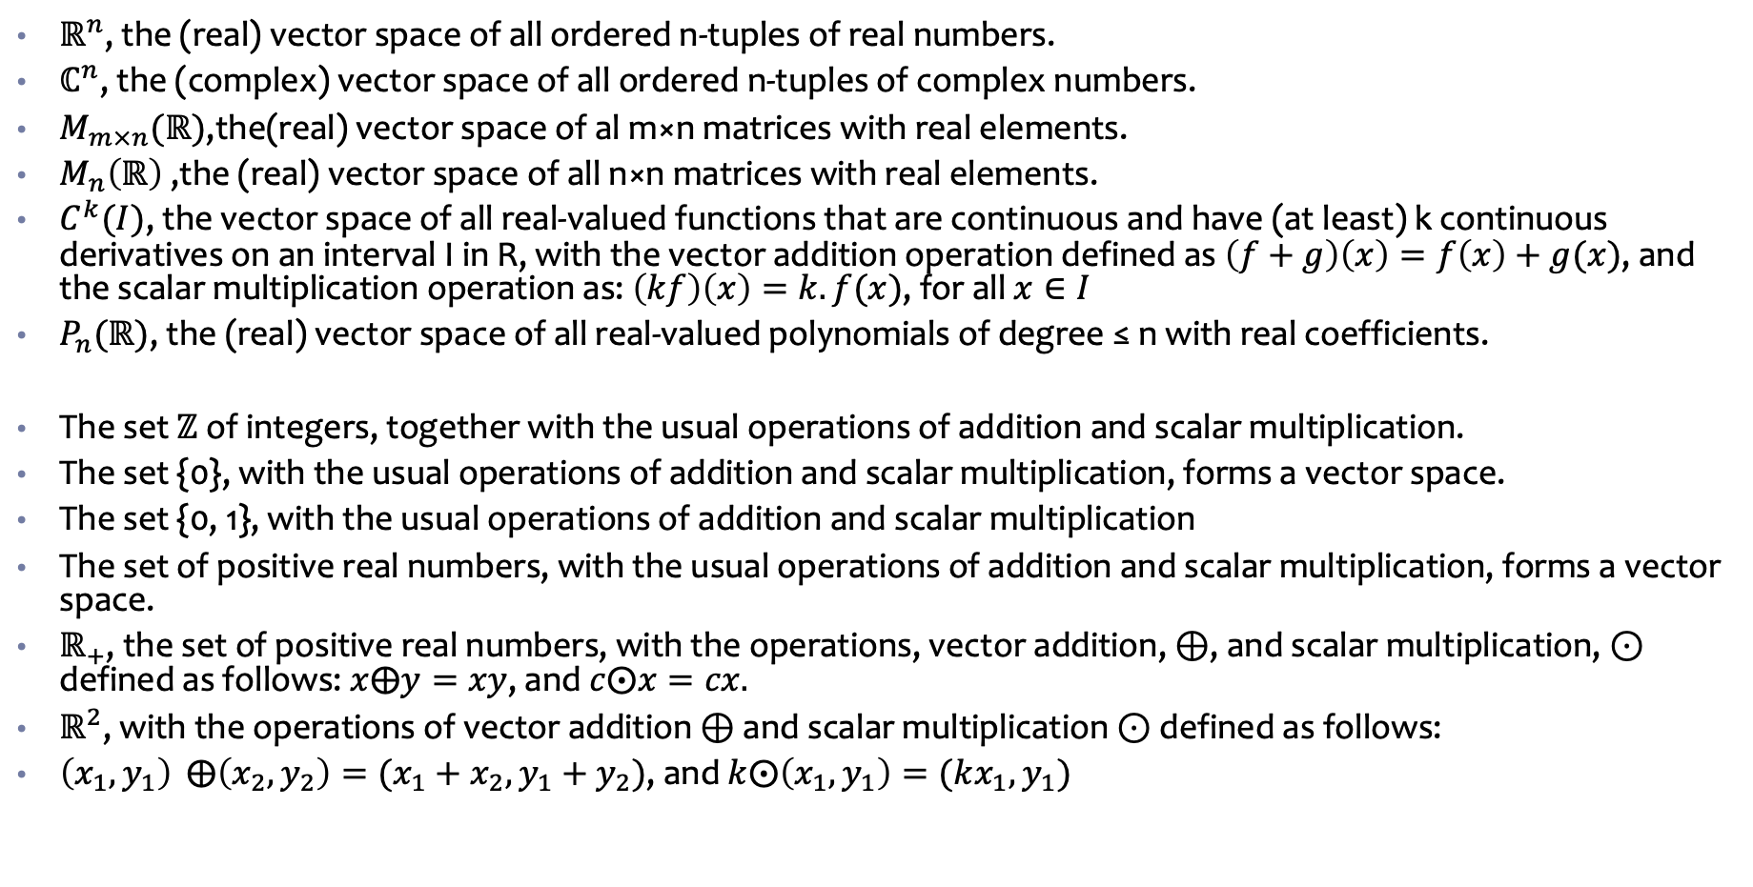
Are these Vectors Spaces?
$ℝ^{n}$, the (real) vector space of all ordered n-tuples of real numbers.
$ℂ^{n}$, the (complex) vector space of all ordered n-tuples of complex numbers.
$M_{m×n}(ℝ)$,the(real) vector space of al m×n matrices with real elements.
$M_{n}\left(ℝ\right)$ ,the (real) vector space of all n×n matrices with real elements.
$C^{k}(I)$, the vector space of all real-valued functions that are continuous and have (at least) k continuous derivatives on an interval I in R, with the vector addition operation defined as $\left(f+g\right)\left(x\right)=f\left(x\right)+g(x)$, and the scalar multiplication operation as: $\left(kf\right)\left(x\right)=k.f(x)$, for all $x∈I$
$P_{n}(ℝ)$, the (real) vector space of all real-valued polynomials of degree ≤ n with real coefficients.
The set $ℤ$ of integers, together with the usual operations of addition and scalar multiplication.
The set {0}, with the usual operations of addition and scalar multiplication, forms a vector space.
The set {0, 1}, with the usual operations of addition and scalar multiplication
The set of positive real numbers, with the usual operations of addition and scalar multiplication, forms a vector space.
$ℝ_{+}$, the set of positive real numbers, with the operations, vector addition, ⊕, and scalar multiplication, ⊙ defined as follows: $x⨁y=xy$, and $c⨀x=cx.$
$ℝ^{2}$, with the operations of vector addition ⊕ and scalar multiplication ⊙ defined as follows:
$\left(x_{1}, y_{1}\right) ⨁{\left(x_{2},y_{2}\right)=(x_{1}+x_{2}, y_{1}+y_{2})}$, and $k⨀\left(x_{1},y_{1}\right)=(kx_{1}, y_{1})$

Slide 9
Basis for a Vector Space

Slide 10
Linear Transformations

Slide 11
Eigenvectors and Eigenvalues

Slide 12
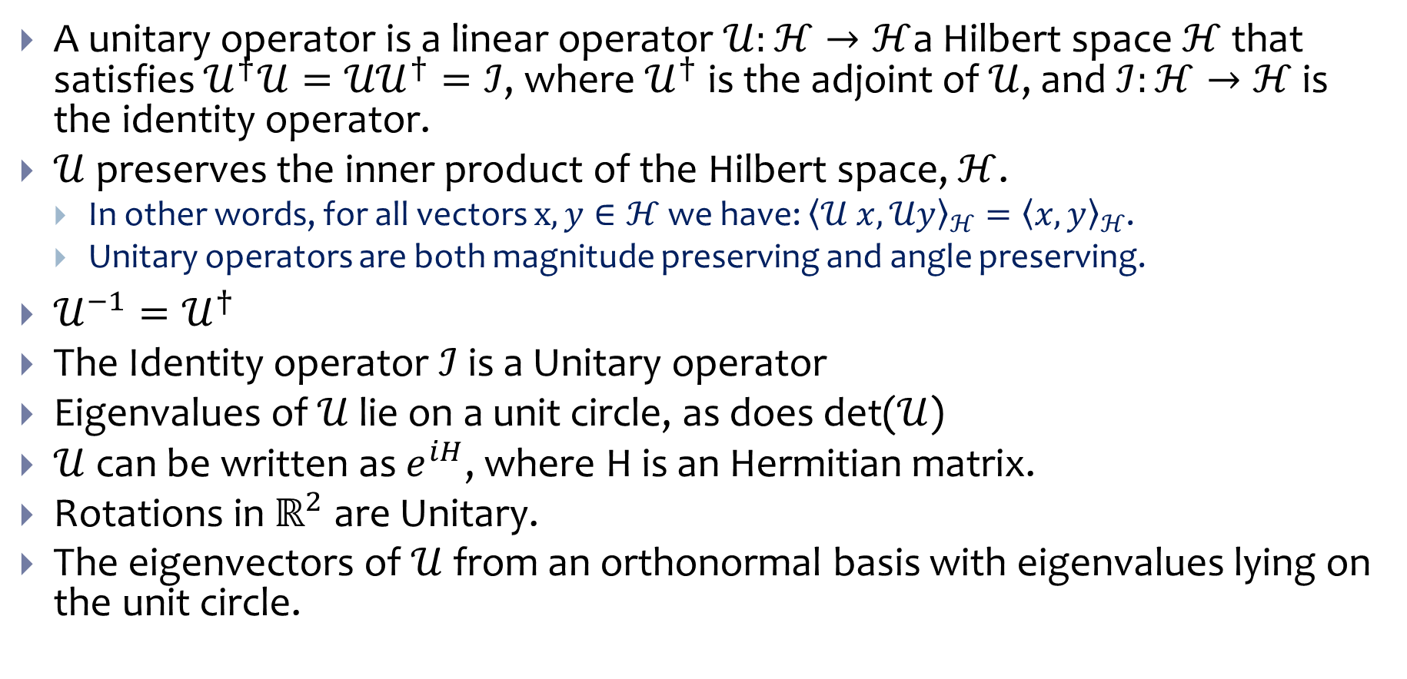
Unitary Operators
A unitary operator is a linear operator $𝒰:ℋ→ℋ$a Hilbert space $ℋ$ that satisfies $𝒰^{†}𝒰={𝒰𝒰}^{†}=ℐ$, where $𝒰^{†}$ is the adjoint of $𝒰$, and $ℐ:ℋ→ℋ$ is the identity operator.
$𝒰$ preserves the inner product of the Hilbert space, $ℋ$.
In other words, for all vectors $x, y∈ℋ$ we have: ${\left\langle 𝒰 x, 𝒰y\right\rangle }_{ℋ}={\left\langle x,y\right\rangle }_{ℋ}$.
Unitary operators are both magnitude preserving and angle preserving.
$𝒰^{−1}=𝒰^{†}$
The Identity operator $ℐ$ is a Unitary operator
Eigenvalues of $𝒰$ lie on a unit circle, as does det($𝒰$)
$𝒰$ can be written as $e^{iH}$, where H is an Hermitian matrix.
Rotations in $ℝ^{2}$ are Unitary.
The eigenvectors of $𝒰$from an orthonormal basis with eigenvalues lying on the unit circle.

Slide 13
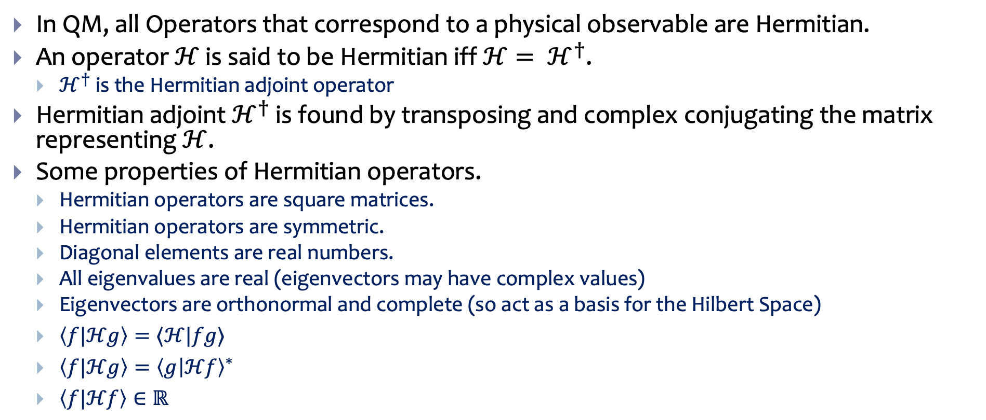
Physical Observables are Hermitian Matrices
In QM, all Operators that correspond to a physical observable are Hermitian.
An operator $ℋ$ is said to be Hermitian iff $ℋ= ℋ^{†}$.
$ℋ^{†}$ is the Hermitian adjoint operator
Hermitian adjoint $ℋ^{†}$ is found by transposing and complex conjugating the matrix representing $ℋ$.
Some properties of Hermitian operators.
Hermitian operators are square matrices.
Hermitian operators are symmetric.
Diagonal elements are real numbers.
All eigenvalues are real (eigenvectors may have complex values)
Eigenvectors are orthonormal and complete (so act as a basis for the Hilbert Space)
$\left\langle f|ℋg\right\rangle =⟨ℋ|fg⟩$
$\left\langle f|ℋg\right\rangle ={\left\langle g | ℋf\right\rangle }^{∗}$
$\left\langle f|ℋf\right\rangle ∈ℝ$

Slide 14
Some properties of Hermitian Operators
Hermitian matrices can be diagonalized by a Unitary matrix.
The sum of any two Hermitian matrices is Hermitian.
Inverse is Hermitian
The product of two Hermitian matrices A and B is Hermitian if and only if AB = BA.
ABA Hermitian
The determinant of a Hermitian matrix is real.

Slide 15
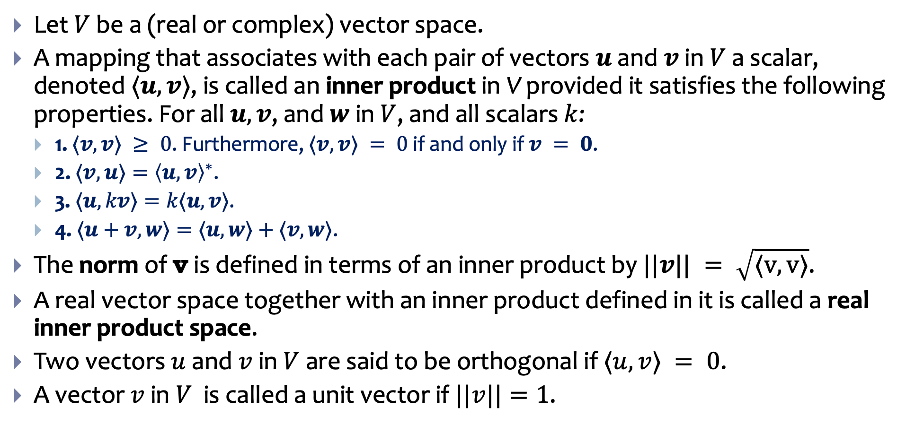
Inner Product
Let $V$ be a (real or complex) vector space.
A mapping that associates with each pair of vectors $u$ and $v$ in $V$ a scalar, denoted $⟨u, v⟩$, is called an inner product in V provided it satisfies the following properties. For all $u, v$, and $w$ in $V$, and all scalars $k$:
1. $⟨v,v⟩ ≥ 0$. Furthermore, $⟨v,v⟩ = 0$ if and only if $v = 0$.
2. $⟨v,u⟩={\left\langle u,v\right\rangle }^{∗}$.
3. $⟨u,kv⟩=k⟨u,v⟩$.
4. $⟨u+v,w⟩=⟨u,w⟩+⟨v,w⟩$.
The norm of v is defined in terms of an inner product by $||v|| = \sqrt{⟨v, v⟩}$.
A real vector space together with an inner product defined in it is called a real inner product space.
Two vectors $u$ and $v$ in $V$ are said to be orthogonal if $⟨u,v⟩ = 0$.
A vector $v$ in $V$ is called a unit vector if $||v||=1$.

Slide 16
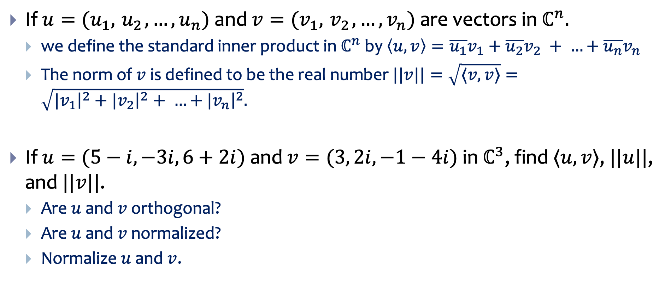

Inner product on $ℂ^{n}$
If $u=(u_{1},{ u}_{2},…,u_{n})$ and $v=(v_{1},{ v}_{2},…,v_{n})$ are vectors in $ℂ^{n}.$
we define the standard inner product in $ℂ^{n}$by $\left\langle u,v\right\rangle ={\overline{u_{1}}v}_{1}+{\overline{u_{2}}v}_{2} + …+{\overline{u_{n}}v}_{n}$
The norm of $v$ is defined to be the real number $||v||=\sqrt{⟨v,v⟩}=\sqrt{{|v}_{1}{\left.​\right|}^{2}+{|v}_{2}{\left.​\right|}^{2}+ …+{|v}_{n}{\left.​\right|}^{2}}.$
If $u=(5−i, −3i, 6+2i)$ and $v=(3, 2i, −1−4i)$ in $ℂ^{3}$, find $⟨u, v⟩$, $||u||$, and $||v||$.
Are $u$ and $v$ orthogonal?
Are $u$ and $v$ normalized?
Normalize $u$ and $v$.

Slide 17

Some properties of inner products
$⟨v,u⟩={\left\langle u,v\right\rangle }^{∗}$
$⟨ax+by, z⟩=a^{∗}⟨x, z⟩+b^{∗}⟨y, z⟩$
$⟨x, ay+bz⟩=a⟨x, z⟩+b⟨y, z⟩$
${\left|\left|f+g\right|\right|}^{2}+{\left|\left|f−g\right|\right|}^{2}=2({\left|\left|f\right|\right|}^{2}+{\left|\left|g\right|\right|}^{2})$

Slide 18
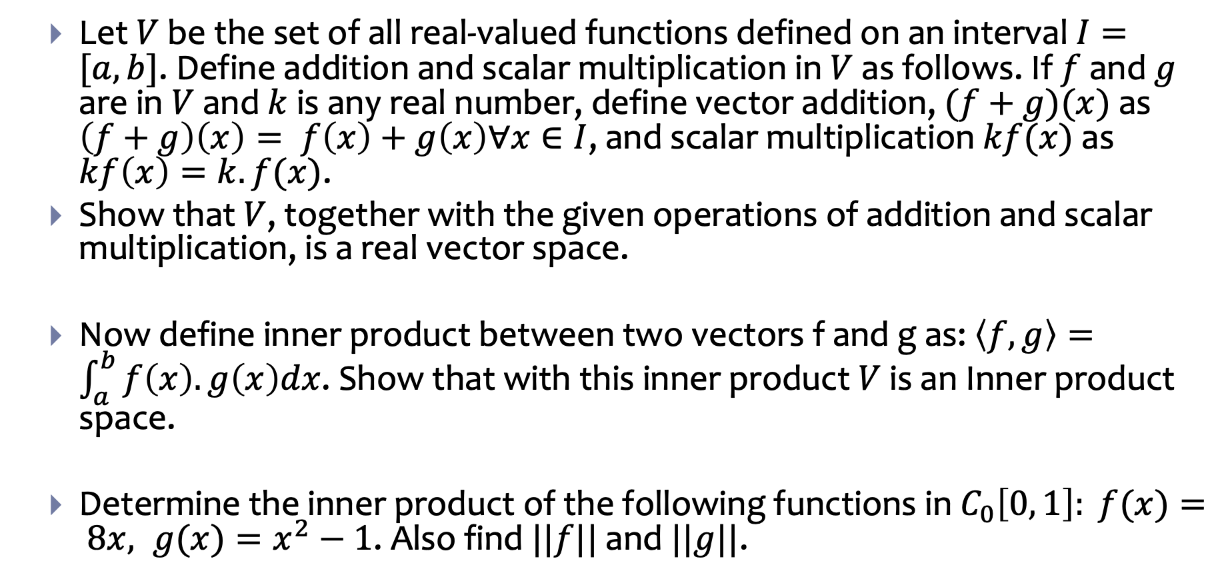
Inner product problems
Let $V$ be the set of all real-valued functions defined on an interval $I=[a,b]$. Define addition and scalar multiplication in $V$ as follows. If $f$ and $g$ are in $V$ and $k$ is any real number, define vector addition, $(f+g)(x)$ as $\left(f+g\right)\left(x\right)= f\left(x\right)+g\left(x\right)∀x∈I$, and scalar multiplication $kf(x)$ as $kf\left(x\right)=k.f(x)$.
Show that $V$, together with the given operations of addition and scalar multiplication, is a real vector space.
Now define inner product between two vectors f and g as: $\left\langle f, g\right\rangle =\int_{a}^{b}{f\left(x\right).g\left(x\right)dx}$. Show that with this inner product $V$ is an Inner product space.
Determine the inner product of the following functions in $C_{0}\left[0, 1\right]: f(x)= 8x, g(x)=x^{2}−1$. Also find $||f||$ and $||g||$.

Slide 19
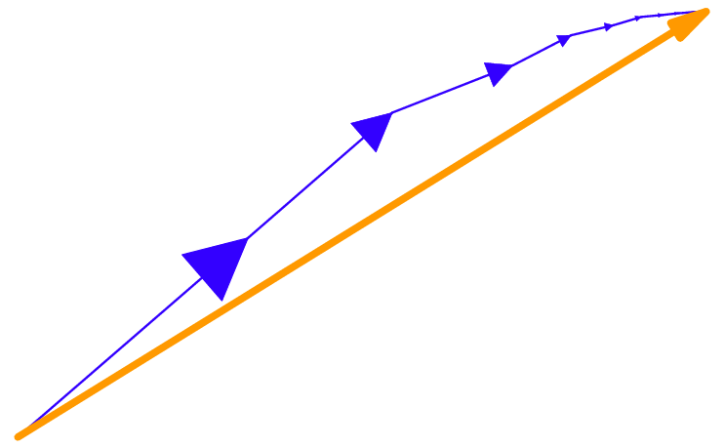
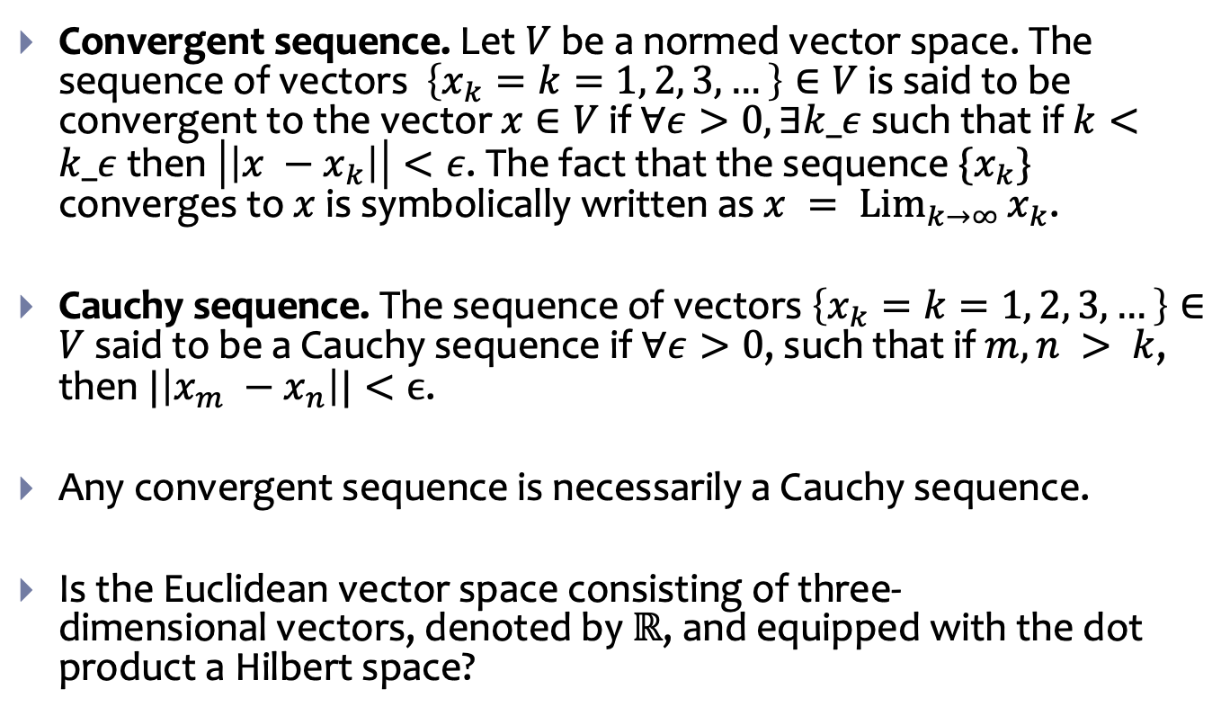
Hilbert Space
Convergent sequence. Let $V$be a normed vector space. The sequence of vectors $\left\{x_{k}=k=1, 2, 3, …\right\}∈V$ is said to be convergent to the vector $x∈V$ if $∀ε>0, ∃k_ε$ such that if $k<k_ε$ then $\left|\left|x −x_{k}\right|\right|<ε$. The fact that the sequence $\{x_{k}\}$ converges to $x$ is symbolically written as $x = \underset{k→∞}{Lim}{x_{k}}$.
Cauchy sequence. The sequence of vectors $\left\{x_{k}=k=1, 2, 3, …\right\}∈V$ said to be a Cauchy sequence if $∀ε>0$, such that if $m, n > k$, then $|\left|x_{m} −x_{n}\right||<ϵ$.
Any convergent sequence is necessarily a Cauchy sequence.
Is the Euclidean vector space consisting of three-dimensional vectors, denoted by $ℝ$, and equipped with the dot product a Hilbert space?

